Slide 1
[ASE 22] Effectively Generating Vulnerable Transaction Sequences in Smart Contracts with Reinforcement Learning-guided Fuzzing
Jianzhong Su, Hong-Ning Dai, Lingjun Zhao, Zibin Zheng, Xiapu Luo

Slide 2


Slide 3


Slide 4
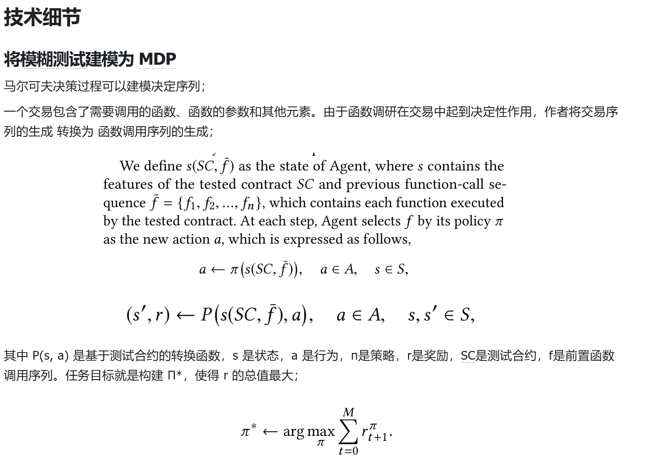

Slide 5
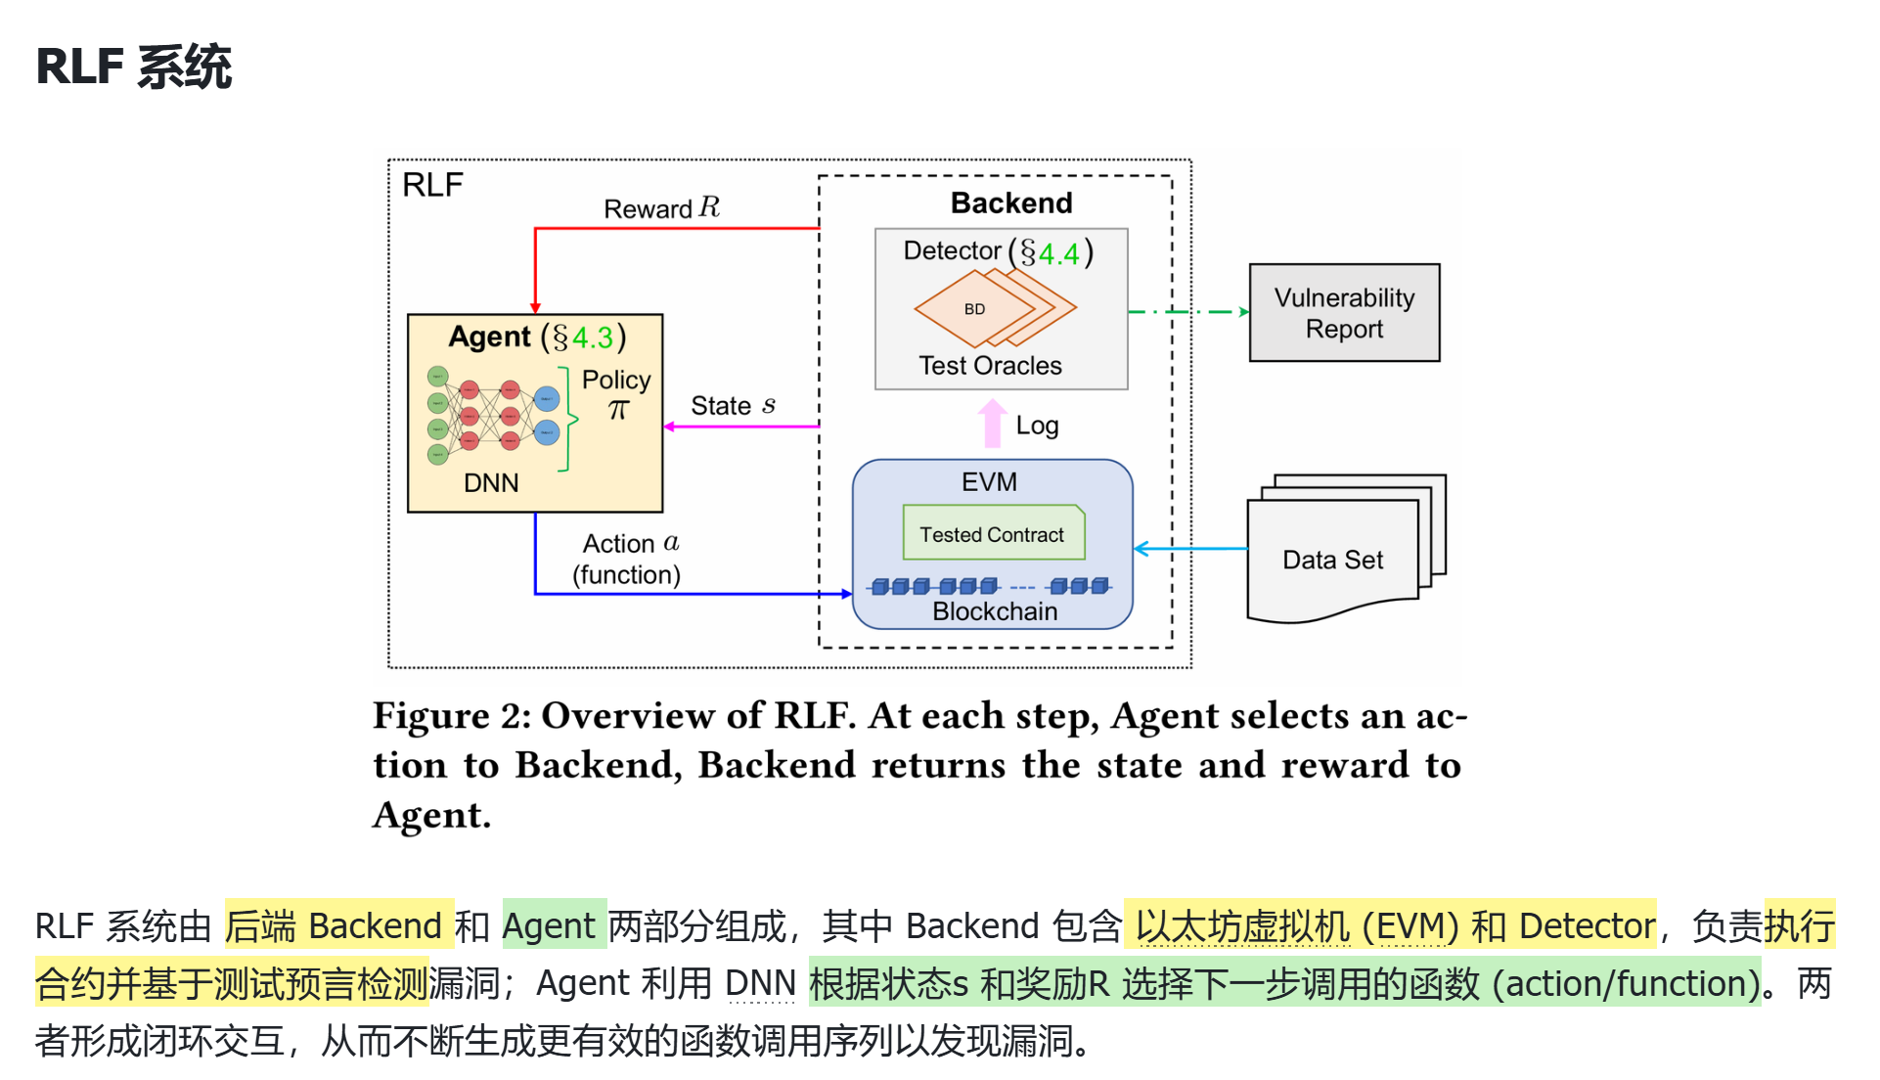

Slide 6
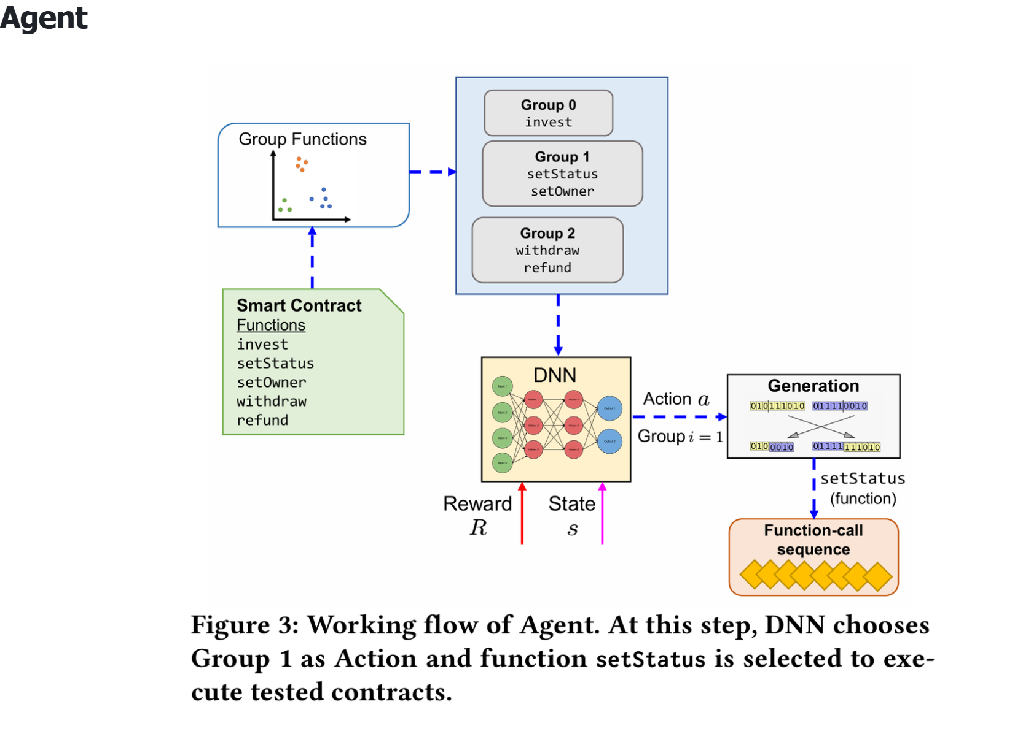

Slide 7
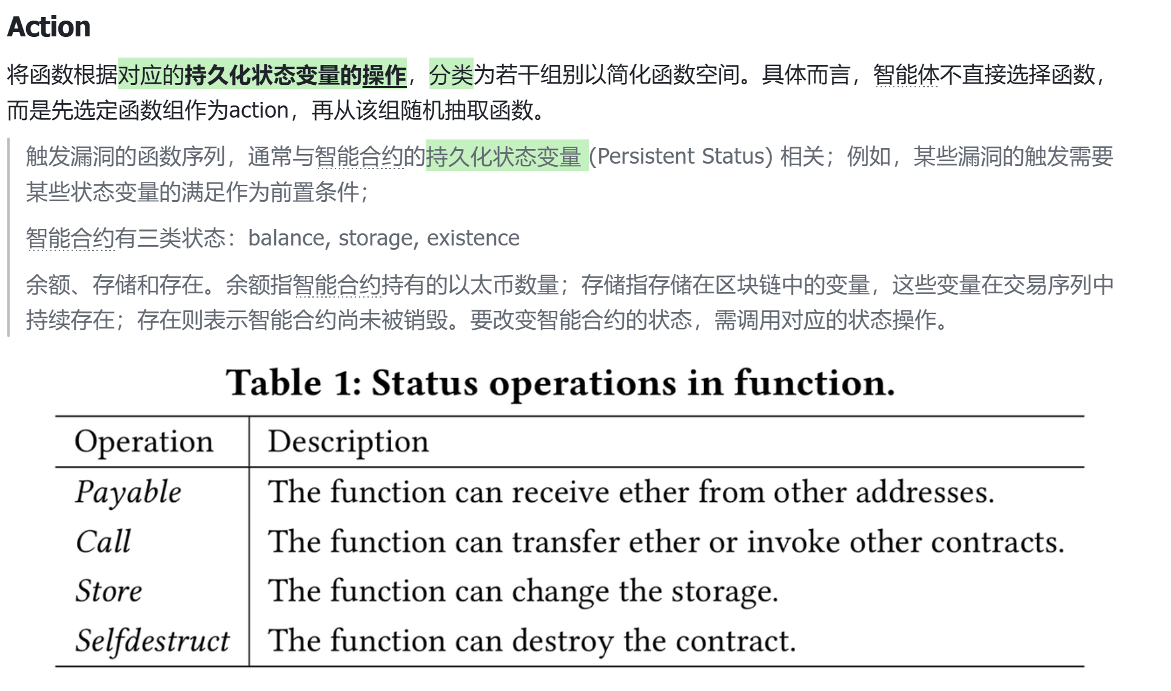

Slide 8
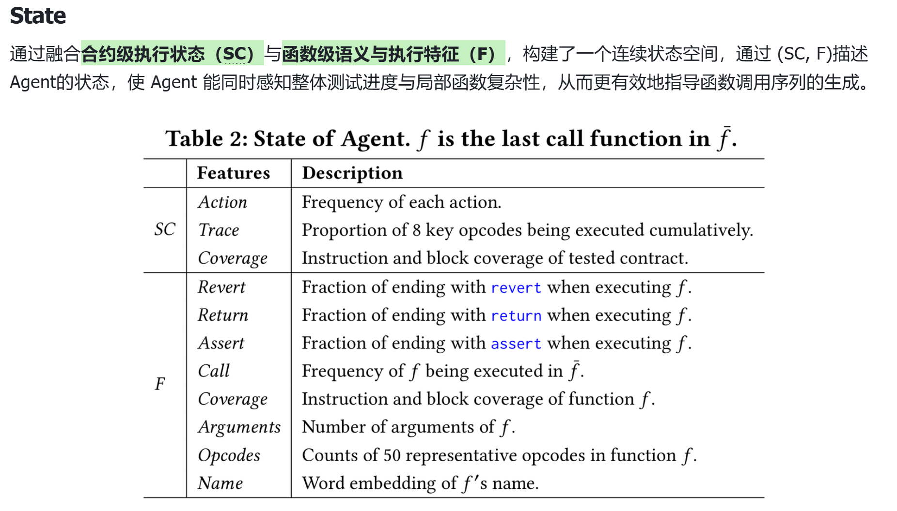

Slide 9
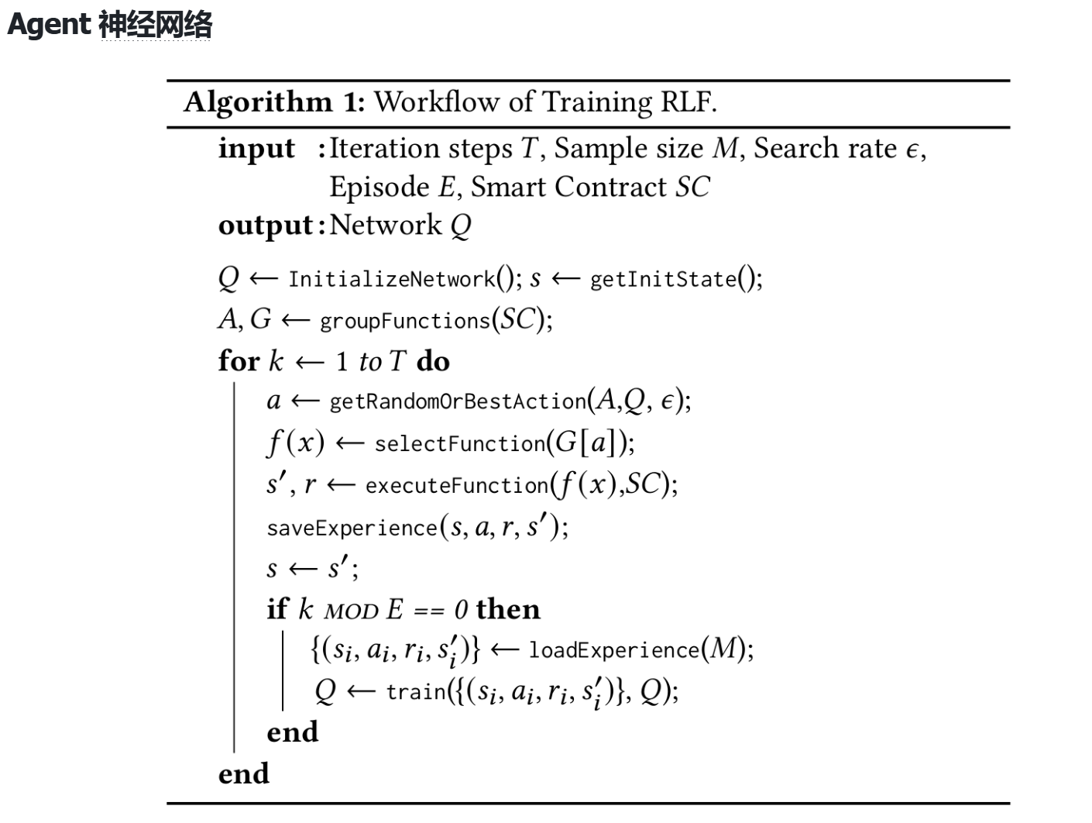

Slide 10


Slide 11
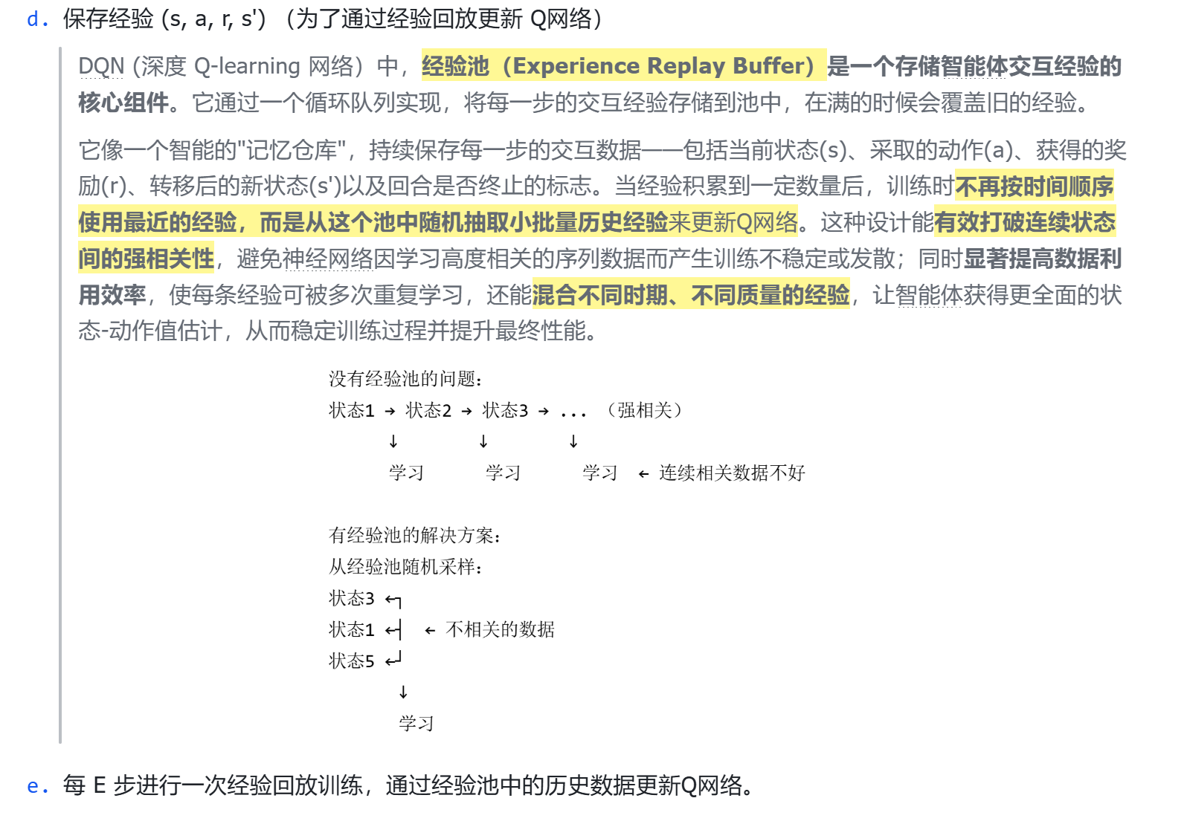

Slide 12
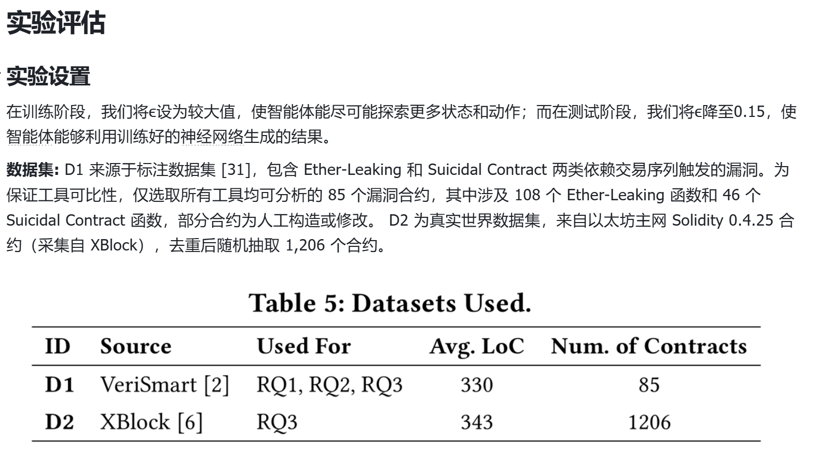

Slide 13
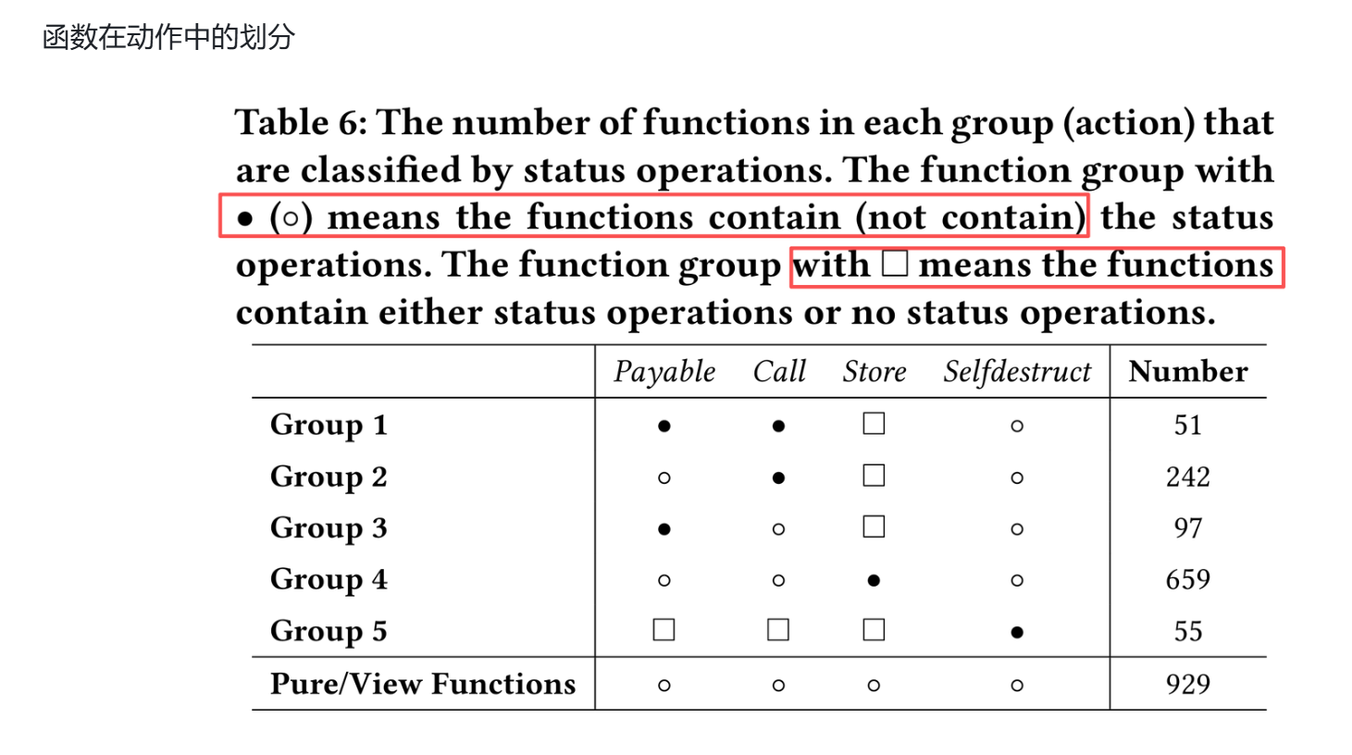

Slide 14
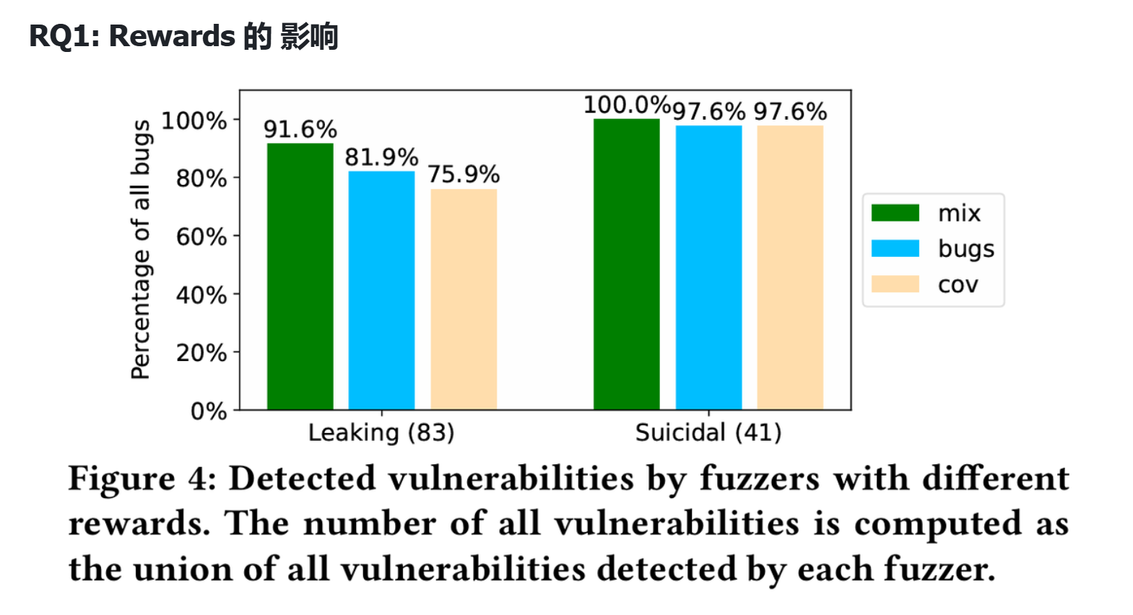

Slide 15
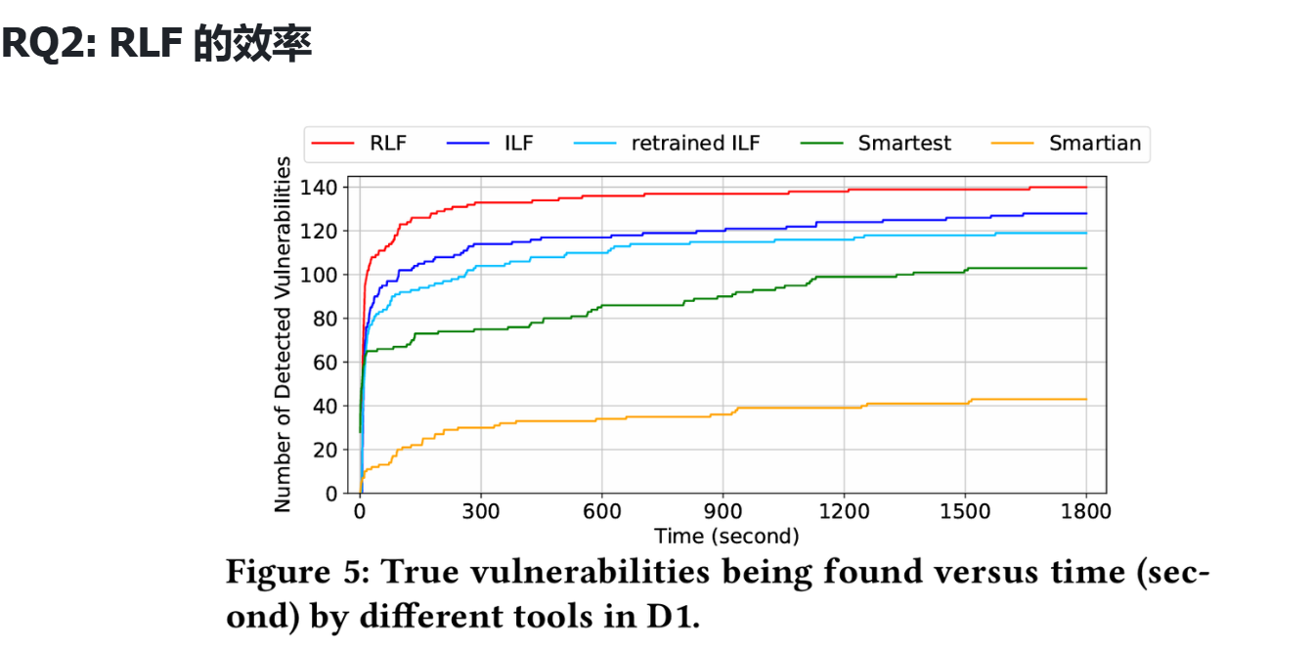

Slide 16
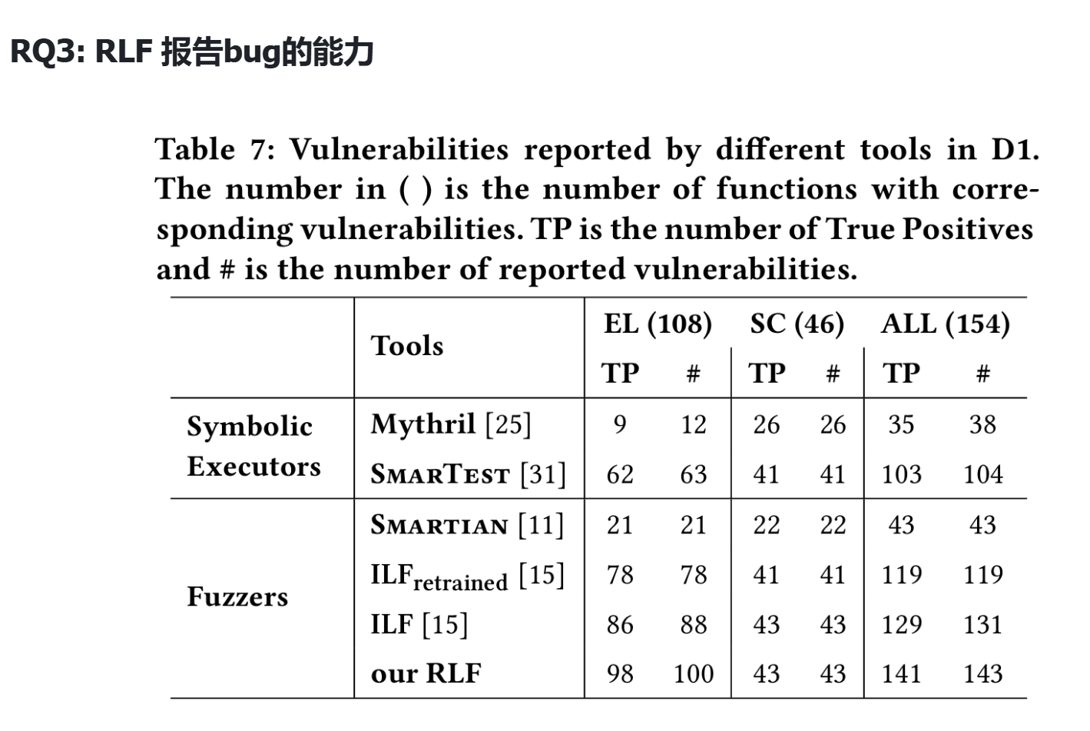

Slide 17


